Slide 1
May 20, 2026 | DeVos Place
Notes:
Chad – Amy as Back-Up
Slide 1 – MiCareerQuest 2026
Talking Points
Welcome everyone and thank them for joining the educator webinar.
Introduce MiCareerQuest 2026, happening May 20, 2026, at DeVos Place.
Set expectations: today’s goal is to help educators feel confident about what MiCareerQuest is, how the day works, and how to prepare students.
Transition into introductions.

Slide 2
Introductions
Event Management – West MI Works!
Director of Development and Innovation, Chad Patton
Project Manager, Jennifer Summers
Project Manager, Marlene Brostrom
Industry Council Leads– West MI Works!
Advanced manufacturing lead, Paul Sischo
Agribusiness lead, Carol Distel
Construction lead, Joshua Perkins
Explore hospitality lead, Brittany Gray
Health sciences lead, Brad Sims
Information technology lead, Virginia Berger
Intermediate Schools Districts (ISDs)
Allegan Area Educational Services Agency, Beth Johnston
Barry ISD, Rich Franklin
Ionia ISD, Dane Sanders & Chad Patton
Kent ISD, Krista Harmon and Ryan Graham
Montcalm Area ISD, Penny Dora & Ashley Reisbig
Muskegon Area ISD, Stephen Pettifor
Ottawa Area ISD, David Ladd
Employer Champions
Advanced Manufacturing
  Jake Hall, The Manufacturing Millennial
  Kacey Regan, DeWys Manufacturing
Agribusiness
  Austyn Baldasare, Hearthside Food Solutions
  Aimee Misiewicz, Herbruck’s Poultry Ranch
Construction
  Kevin Lutz, Feyen Zylstra
  John A. Hartwell, Operating Engineers Local 324
Explore Hospitality
  Heather Day, Gerald R. Ford Airport
  Lisa Calhoun, Kent County Hotel Association, Sheraton
  Amy Young, Destination Consultants
Health Sciences
  Steven Smith, University of Michigan Health - West
Information Technology
  Eileen Boekestein, Michigan Department of Environment, Great Lakes, and Energy
  Sharon Vriend-Robinette, Corewell Health Information Technology
Notes:
Chad – Amy as Back-Up
Slide 2 – Introductions
Talking Points
Introduce West Michigan Works! event leadership and project managers.
Acknowledge the Industry Talent Council Leads and the six industries represented.
Recognize ISD partners across the region—emphasize this is a regional, collaborative effort.
Acknowledge Employer Champions by industry.
Emphasize: MiCareerQuest is truly a community-driven event.

Slide 3

In the next five years:
Baby Boomers will be approximately 61-80 years old
The first Gen Xers will become eligible for Social Security and Medicare and begin to retire in 2027
We need to add 4.6 million workers every year to replace them as they retire.
The
Need
What are we doing to ensure they choose a career in:
Agribusiness
Hospitality?
Advanced Manufacturing?
Information Technology?
Health Sciences?
Construction?
Notes:
Chad – Amy as Back-Up
Slide 3 – The Need
Talking Points
Frame the workforce challenge: Highlight aging demographics—Baby Boomers and Gen X entering retirement.
Emphasize the scale: 4.6 million workers per year needed nationally just to replace retirees.
Pose the core question: How are we ensuring students see careers in these industries as real options?
One powerful solution for our community is MiCareerQuest.
MiCareerQuest is an innovative, hands-on career exploration event designed to connect students with real-world experiences in high-demand industries. It was launched in 2015 through a partnership between Michigan Works! Kent, Allegan & Barry Counties (now West Michigan Works!), Kent ISD, and the Construction Workforce Development Alliance (CWDA). The event was created in direct response to employers’ urgent need for future talent in four key sectors: construction, health care, information technology, and manufacturing.
Since its inception, MiCareerQuest has grown beyond our region. It’s now recognized as a statewide best practice, and similar events—under the CareerQuestUSA banner—are being hosted across the country. These events share the same mission: to expose students to the wealth of career opportunities available in their communities and inspire the next generation of talent.
As we prepare to kick off outreach for this year’s event, remember that MiCareerQuest isn’t just an activity—it’s a strategic investment in our future workforce. Your role in promoting and supporting this initiative helps ensure that students, educators, and employers all see the value and impact of participating.

Slide 4

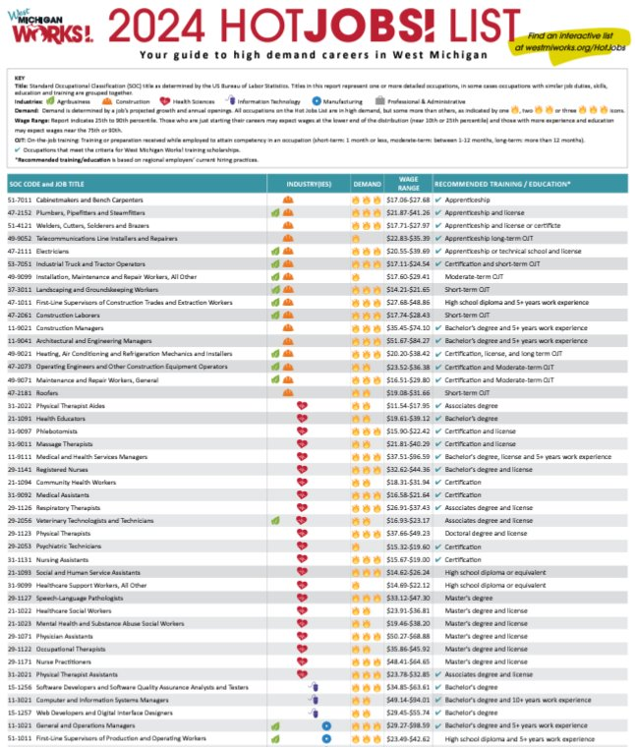






Industry Talent Councils
The data-based HotJobs! List guides which jobs are featured at the event.
Notes:
Amy
The event is backed by the 6 employer-led industry talent council, who's logo are displayed on the screen. Each council is committed to solutions to address the skilled workforce needs of West Michigan companies. A few key areas of focus for each industry are: promoting the industry, recruitment, retention, and funding for talent related initiatives.
Who They Are:
Employers, educators, workforce development experts
What They Do:
Create solutions to address the skilled workforce needs of West Michigan companies
One way that they do this:
MiCareerQuest
Guiding resource: Hot Jobs List

Slide 5
  What
  Interactive, hands-on, purposeful, inspiring
When
Event Day - Wednesday, May 20, 2026
Students arrive at 8:30 a.m.
Event ends at 1:45 p.m.
Where
DeVos Place Convention Center
303 Monroe Ave NW, Grand Rapids, MI 49503
Event Overview
Notes:
Amy – Jennifer as Back-Up
When and where
What:
MiCareerQuest is not your average career fair. In fact, it’s not a career fair at all. It’s a career exploration experience.
During MiCareerQuest, students rotate through sectors highlighting six high-demand industries: agribusiness, advanced manufacturing, construction, health sciences, hospitality, and information technology. Students engage directly with professionals and participate in activities that showcase various high-growth occupations, opening their eyes to opportunities for great careers in West Michigan.
Additionally, representatives from educational institutions help students make the connection between training, education and careers.

Slide 6
DeVos hall will be divided into four industry quadrants.
Industry champions will have interactive, engaging, and motivating exhibits showcasing the career opportunities within their industry.
Higher Education Sponsors will be strategically placed throughout DeVos hall to maximize exposure to students.
Quadrants will be piped and draped in a color matching initial lanyard entrance color, with an entrance and an exit to facilitate student movement.
The Layout
Notes:
Amy – Jennifer as Back-Up
Slide 6 – The Layout (Overview)
Talking Points
Explain that DeVos Hall is organized into four industry quadrants.
Employers are positioned to create engaging, hands-on experiences.
Higher education partners are intentionally placed for visibility.
Color-coded quadrants and entrances/exits help manage safe student flow.

Slide 7
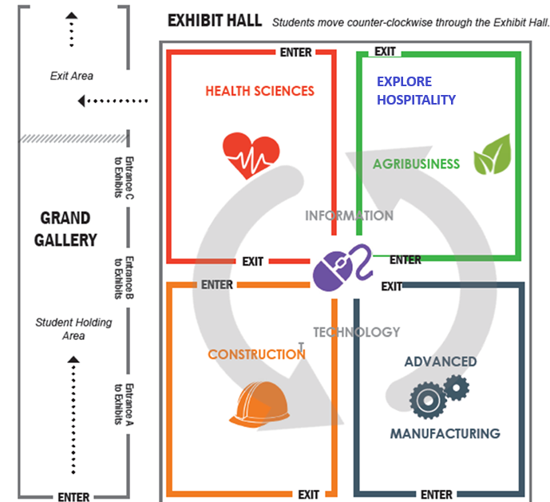
The Layout
Notes:
Amy – Jennifer as Back-Up
Slide 7 – The Layout (Map View)
Talking Points
Walk participants through the visual layout.
Reinforce how color, signage, and exits guide students.
Emphasize that flow is structured to avoid congestion and keep students engaged.
Quadrants will be piped and draped in a color matching initial lanyard entrance color, with an entrance and an exit to facilitate student movement.

Slide 8
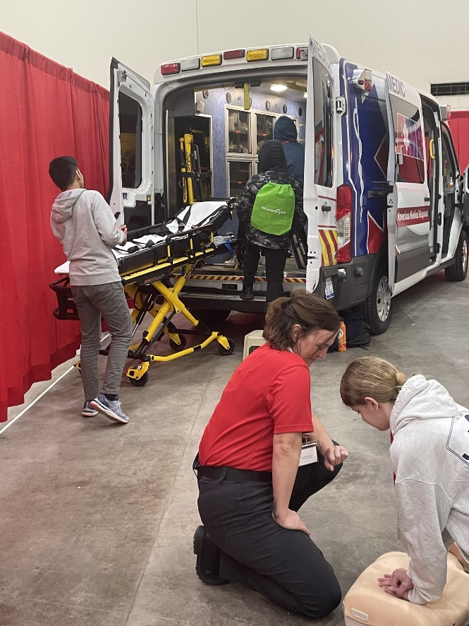

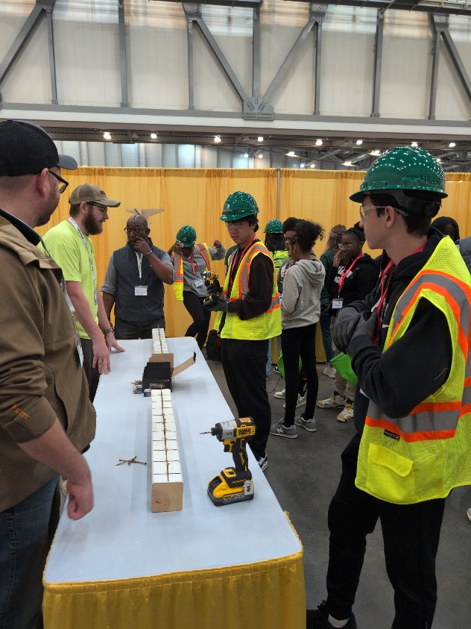
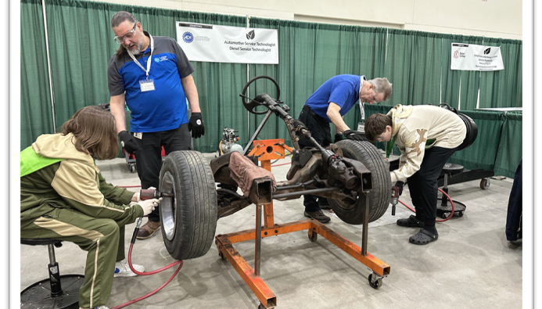
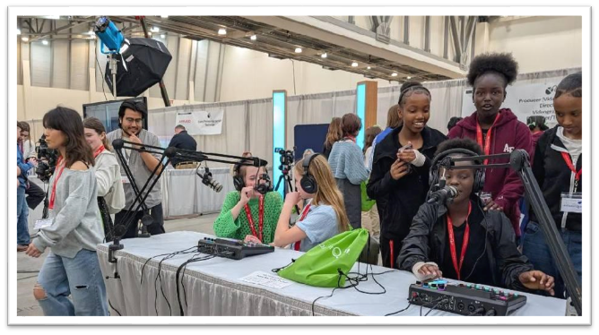
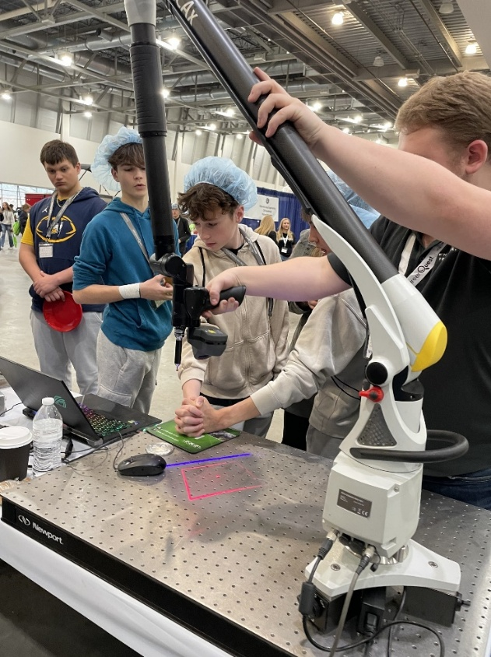
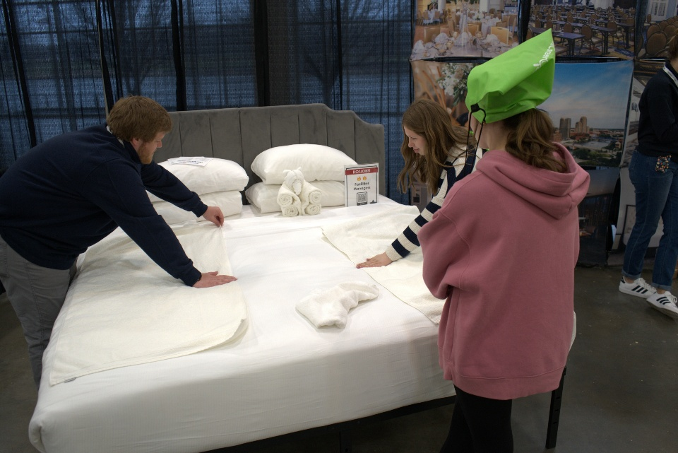
Notes:
Amy – Jennifer as Back-Up
Students can’t aspire to careers they’ve never seen—and we want to go beyond simply showing them what’s possible. At MiCareerQuest, students don’t just observe; they experience careers through hands-on activities like the ones pictured here. These interactive experiences help students imagine themselves in these roles and spark curiosity about their future.
During the event, students rotate through sectors that highlight our six high-demand industries. They meet industry professionals, ask questions, and participate in activities that demonstrate what these careers look like day-to-day. This approach opens their eyes to opportunities for rewarding careers right here in West Michigan.
In addition, representatives from educational institutions are on hand to help students connect the dots between training, education, and career pathways. This ensures they leave with a clearer understanding of what it takes to pursue these opportunities.
To give you a sense of scale, this past spring nearly 8,500 students attended MiCareerQuest. They engaged with 90 companies and explored over 290 different jobs. That’s a powerful impact—and it’s why your role in promoting this event is so important.

Slide 9
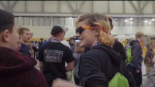
What is MiCareerQuest?
…and agribusiness/hospitality!
Notes:
Amy – Jennifer as Back-Up
Employers participating in their first MiCQ event, often state they wish they was a better way to prepare employers for what they would experience. This video showcases activities from a previous event
We would like play that for you now.

Slide 10
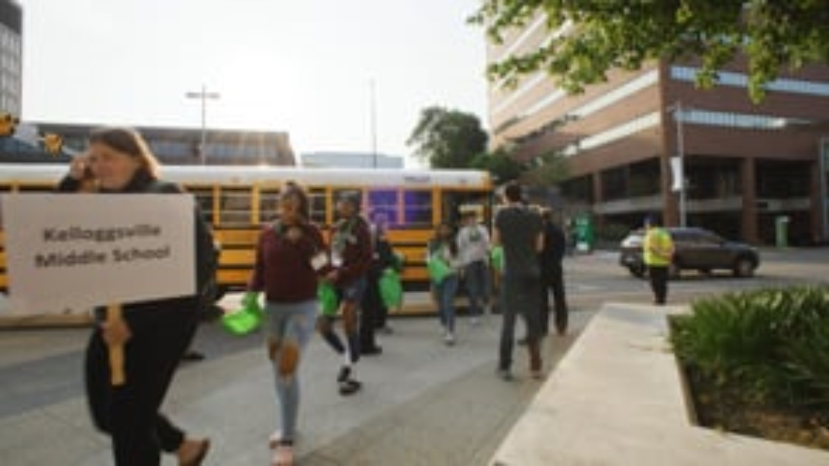
Video: MiCareerQuest Student Journey
Notes:
Amy – Jennifer as Back-Up
And here is a video from the students’ perspective.

Slide 11
    8,281 students registered.
    99 participating employers
    309 careers featured
2026 Highlights
“What I liked best was that it showed how many different options there were for things I could do after high school, it was nice to see things that i wasn't interested in before :)” – 2025 Student Participant
Notes:
Chad – Amy as Back-Up
Slide 11 – 2026 Highlights
Talking Points
Share participation numbers: students, employers, careers.
Read or paraphrase the student quote.
Emphasize student perspective—exposure matters, even for careers they didn’t expect to like.

Slide 12
Student media (in school newspapers, video reporting programs) are invited to attend using press passes.
Reach out to cpatton@westmiworks.org with teacher or student media contact.
Photographs and videos will be taken and may be used in promotional materials regarding MiCareerQuest without a release. Please ensure all students attending are able to have their pictures and videos taken at this large, public event.
Video interviews: we will seek parent/guardian release of student interviews taken for promotional purposes. Reporters may have different policies.
Anonymized survey responses will be used
Photos/
Media
Notes:
Chad – Amy as Back-Up
Slide 13 – Photos & Media
Talking Points
Explain student media opportunities – If schools have student-run newspapers, we encourage them to come. Reach out to Chad
Clarify expectations around photography and video use – photos will be taken and they will only be used for informational purposes
Stress the importance of ensuring all attending students are cleared for photos.
We may have videos of students – we will specifically request release forms under those circumstances
Mention anonymized survey data will be used as we ask students to fill out a survey after the event

Slide 13
Prepare students for the employers at the event (Educator Packet) and jobs represented by industry (Educator Packet).
Review Educator Packet: Student activities, with post-event activity! Very important to do before MiCQ – helps prepare students!
Questions for exhibitors – Most important
Online resources available with additional activities (mynextmove.org)
Pre-Event Activities
Notes:
Chad – Amy as Back-Up
Slide 14 – Pre-Event Activities
Talking Points
Stress that preparation directly improves student engagement.
Highlight the Educator Packet and student activities – Your ISD leads should have sent out a number of documents ahead of the event
Emphasize developing questions for exhibitors as the most important prep step – Exhibitors will be prepared for questions
Mention additional online career exploration tools.

Slide 14
3D Walkthrough Instructions
Link to 2025 3D Walkthrough
2026 Maps
Videos: For Students
Pre-Event Activities
Notes:
Chad – Amy as Back-Up
Slide 15 – Pre-Event Activities (Resources)
Talking Points
Walk through available digital tools: 3D walkthroughs, maps, student videos.
Encourage using these to reduce anxiety and improve navigation on event day.
I recommend showing the 3D walkthrough and also showing the 2026 Maps – click on those links to demonstrate
What are some activities you have done leading up to this event?
When do you start preparing students for the event?

Slide 15
On the bus to MiCareerQuest:
Review potential questions to ask employers at the event.
Review expectations for students at event. There are many activities, so students do not generally move as a single class.
Review exit plans: students leave DeVos and then go left then right at the bridge to cross the Grand River.
Remember to bring lanyards and inserts!
Extra available at info desk
Pre-Event Activities
Notes:
Chad – Amy as Back-Up
Slide 16 – Pre-Event Activities (On the Bus)
Talking Points
Reinforce expectations and student independence – have students continue to think through questions on the bus
Discuss the importance of visiting what is interesting to them as individuals – ask questions
Review exit plans before arriving.
Stress importance of lanyards and inserts—and note extras are available if needed.

Slide 16
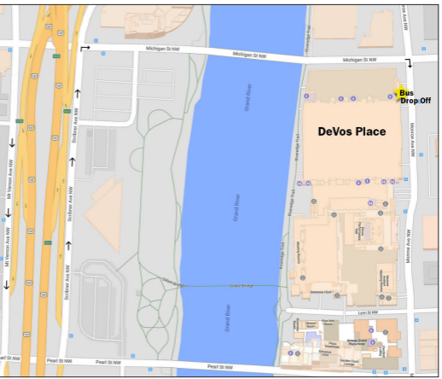
Buses will line up on SCRIBNER AVENUE and wait to be directed by event staff to proceed to drop off.
Buses will turn right onto MICHIGAN then turn right onto MONROE AVE.
Buses will drop off at the designated area on MONROE AVE (volunteers will be present to assist).
For the safety of students there will be NO DOUBLE PARKING TO UNLOAD.
Please unload as quickly as possible
Volunteers will be present to enforce the drop off process
Pick up will be on SCRIBNER AVE
Arrival
Notes:
Chad – Amy as Back-Up
Carefully walk through bus routing.
Note that there will be bus greeters getting on the bus to prepare students for the event
Emphasize no double parking for safety.
Preview that pick-up procedures are different from drop-off and we will discuss that process in later slides

Slide 17
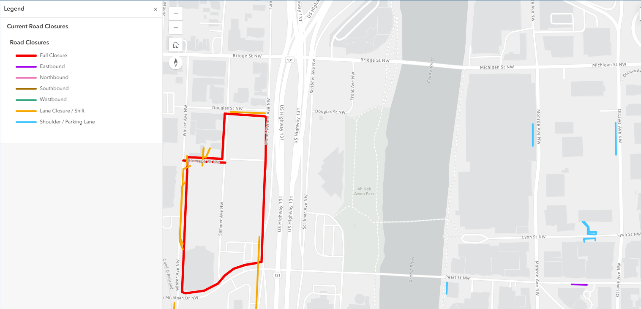
Mt. Vernon is down to a single lane due to soccer stadium construction
No other major road closures to note this year
Road Closures
Notes:
Chad – Amy as Back-Up
There are no road closures listed for the event OTHER THAN Mt. Vernon will not be a back-up options for bus parking.

Slide 18
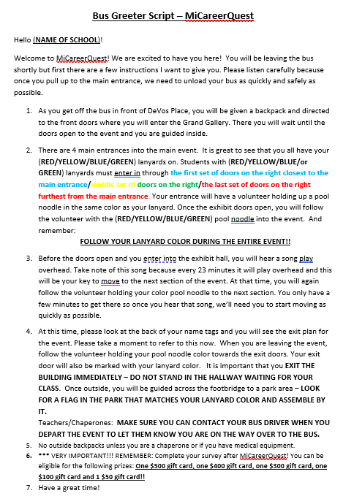
Arrival: Greeting
Notes:
Chad – Amy as Back-Up
Slide 18 – Arrival: Greeting
Talking Points
Explain greeting process and where schools will be welcomed. You don’t need to read this
Know that the script will provide detailed information to students about what they need to do to enter the event and where they should go
Reinforce that this sets the tone for the student experience and that they should listen to the greeting

Slide 19
Every student and chaperone should have lanyard
Chaperone will complete survey questions on mobile phone using QR code
Arrive to DeVos Place and in exchange for information about number of students, you will receive:
1. School sign to gather after MiCareerQuest with
2. Surveys to give to students on bus ride home
3. MiCareerQuest backpacks for all students
No outside backpacks allowed: One chaperone should bring a backpack to hold their sign during MiCareerQuest. Medical devices and medical products are allowed, but all bags, including chaperone bag, subject to inspection.
Arrival
Notes:
Chad – Amy as Back-Up
Slide 19 – Arrival (Check-In & Materials)
Talking Points
Confirm lanyards for all students and chaperones.
Explain survey process and materials received. Read the 3 bullets
Emphasize no outside backpacks policy and bag inspections.
Clarify exception for medical needs.

Slide 20
The city encourages school and other buses to park on-street in dedicated bus parking
Bus Parking is available on Scribner Ave (one way north) between Pearl and Bridge street, and
North of Bridge Street continuing north on Scribner Ave
Bus parking is on a first-come-first-served basis.
Bus Parking
Get bus driver’s phone number to
reconnect after event
Notes:
Chad – Amy as Back-Up
Slide 20 – Bus Parking
Talking Points
Stress importance of getting the driver’s phone number.
Review parking locations and first-come nature of spots – Note that Scribner north of Bridge is new overflow parking area
Reinforce safety and coordination.

Slide 21
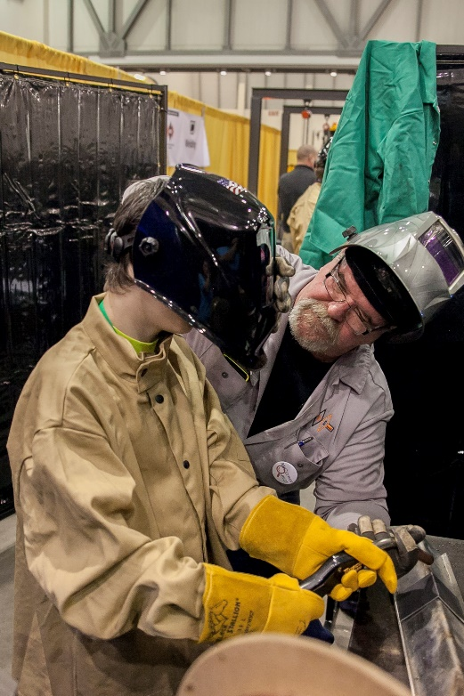
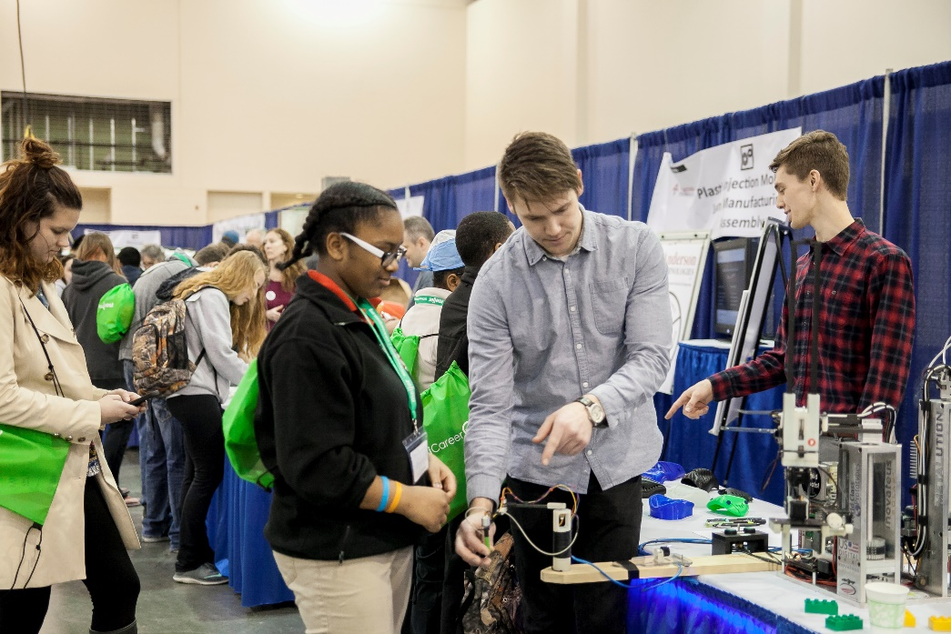
Students come in from one of three sessions:
    8:30 am – 10:15 am
    10:15 am – noon
  12pm – 1:45 pm
  Students start in one of the exhibit spaces and move throughout the hall to experience all six industries.
Student Experience
Notes:
Amy – Jennifer as Back-Up
Slide 21 – Student Experience (Sessions)
Talking Points
Explain the three session times.
Reinforce that students experience all six industries through rotation.

Slide 22
Students will arrive via the Monroe entrance and will wait in the Grand Gallery until their assigned start time.
23 minutes in each industry sector.
Music marks when students will need to switch quadrants. Follow their color pool noodles.
If you need to leave early, reach out to Chad at cpatton@westmiworks.org or notify the overhead announcer stationed near the concession stand if day of event
Student Experience
Notes:
Amy – Jennifer as Back-Up
Slide 22 – Student Experience (Flow Mechanics)
Talking Points
Explain waiting in Grand Gallery before sessions. Entrance is signalled by air horn
Review 23-minute rotations and music cues. 3 minutes to transition between quadrants.
Explain color pool noodle system and what the noodles mean
Provide clear guidance for early departure communication.

Slide 23
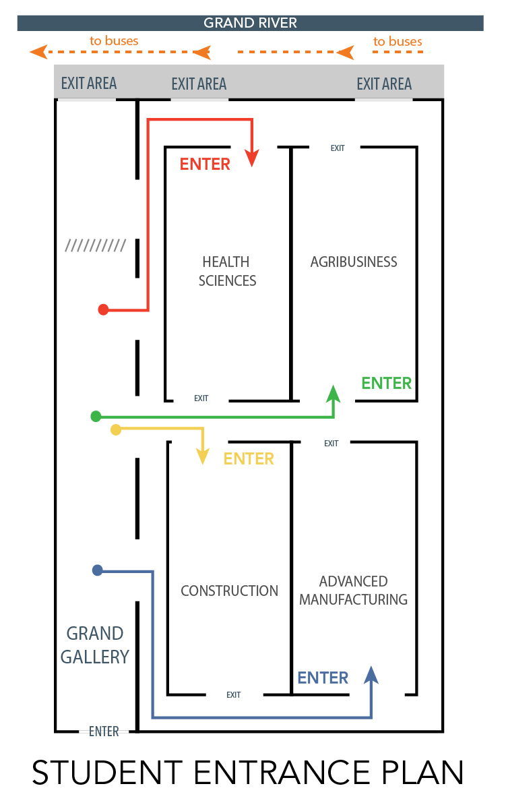
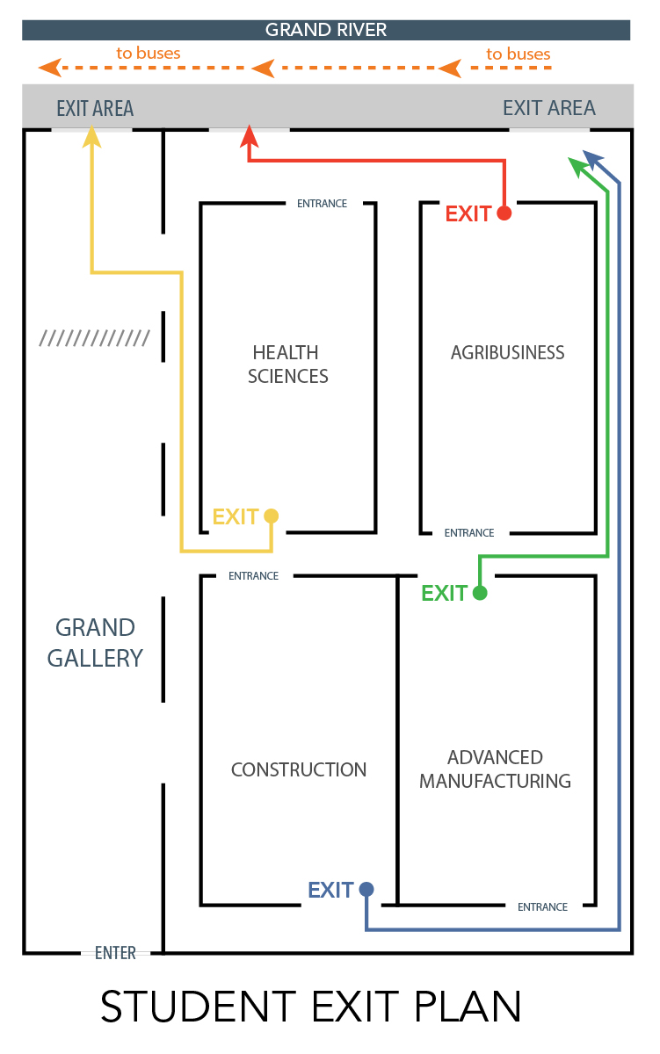
Student Flow
Bus Drop Off
Notes:
Amy – Jennifer as Back-Up
Students start in Grand Gallery, and have been assigned by lanyard color to start in a quadrant, then flow through counterclockwise. They have about 23 minutes per quadrant, with time for moving between rooms. After students have completed a full rotation, they exit to the busses, and the next Session of students immediate.
Note that these images will be on the back of each student’s lanyard

Slide 24
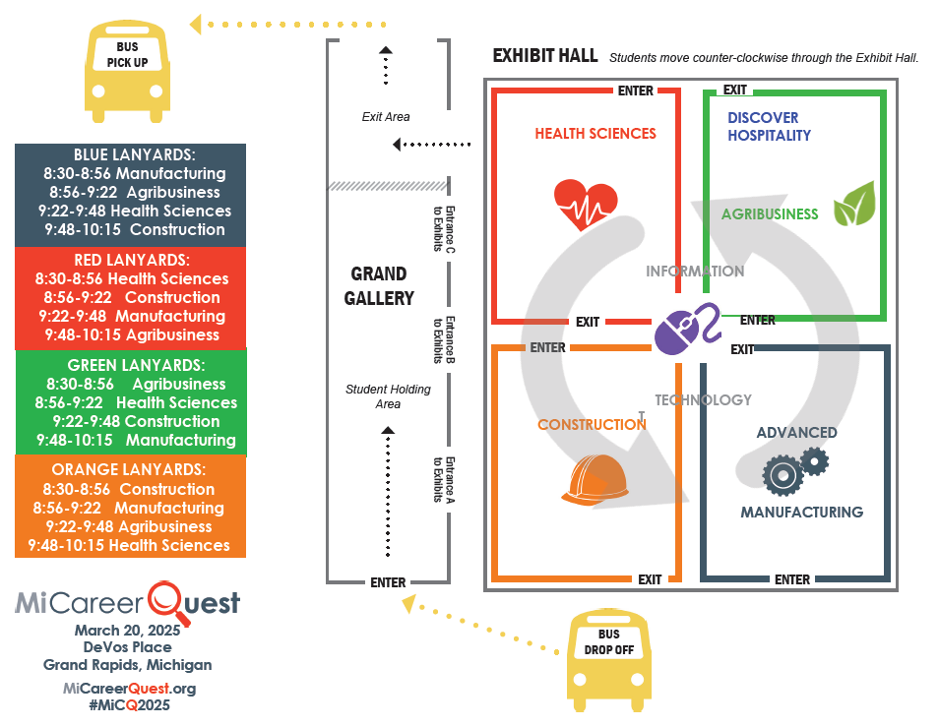

Student Flow
Notes:
Amy – Jennifer as Back-Up
Reinforce that this is another image that shows:
The specific times for each lanyard (note this is just Session I)
The rotation after each 23 minute session
The layout of the 6 industries within the quadrant structure

Slide 25
EXIT PLANS
Color papers will show doors to exit from
Carpool/chaperone-driven students: Exit same way. After DeVos Place building, break left to go to parking lot (bus driven students will go right to go over Grand River)
Exit Plan on
every student lanyard
Notes:
Amy – Jennifer as Back-Up
Slide 25 – Exit Plans
Talking Points
Highlight exit instructions printed on student lanyards.
Review difference between bus and carpool exits.

Slide 26
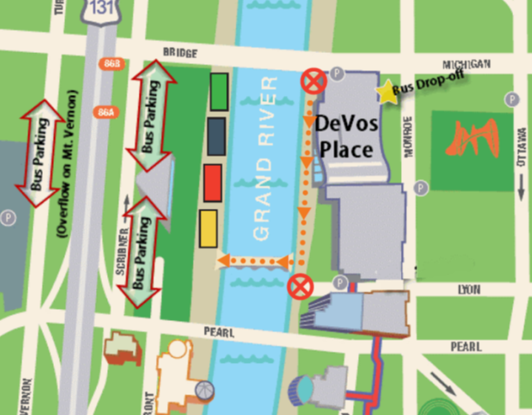
Exterior Exit Plan
Use your school sign to meet your
students here, arranged by lanyard colors. USE BUDDY SYSTEM.
Breakaway for chaperone-
driven students
Wear weather appropriate clothing.
Will take 15-20 minutes to gather after session ending.
Notes:
Amy – Jennifer as Back-Up
Slide 26 – Exterior Exit Plan
Talking Points
Walk through the map to show:
Where students get dropped off
Where they will exit – NOTE: students should keep moving and not block the doors
Where they cross the bridge
Where they will wait for their teachers/chaperones
Explain gathering by school sign and lanyard color.
Stress buddy system and weather readiness.
Set expectations for gathering time post-session.

Slide 27
A Note About the Exit Plan
Session II Exit guides are a combination of Criminal Justice Students and Volunteers
  The Exit Team has been instructed to stop schools from gathering immediately outside the exit doors
  Please take count of your students once across the bridge
  Reminder: CJ students are high school students; we have had complaints of chaperones pushing these teenagers
  Whether they are General Volunteers or CJ students please be respectful and help us to clear the exits and exhibit halls
Exterior Exit & CJ Students
Notes:
Chad – Amy as Back-Up
Slide 27 – Exit & CJ Students
Talking Points
The main reason for this slide is because CJ instructors had issues with adults being mean/pushing CJ students
Reinforce respectful treatment of CJ students and volunteers.
Emphasize accurate student counts after crossing the bridge.
We want to limit bottlenecks when we exit, so please leave and cross the bridge promptly

Slide 28
Students receive survey link via QR code. Have them fill this out on bus ride back. DO NOT GIVE OUT BEFORE.
Educator survey available on micareerquest.org – SCECH credit available
Prizes available for survey responses for educators and students
Bus ride home
Notes:
Chad – Amy as Back-Up
Slide 28 – Bus Ride Home
Talking Points
Stress timing: surveys should be provided on the bus ride home, not before
Mention SCECH credit opportunity – must complete survey today and educator survey after event to get credit
Encourage participation by highlighting prizes.

Slide 29
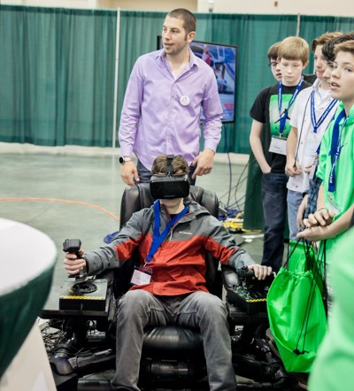
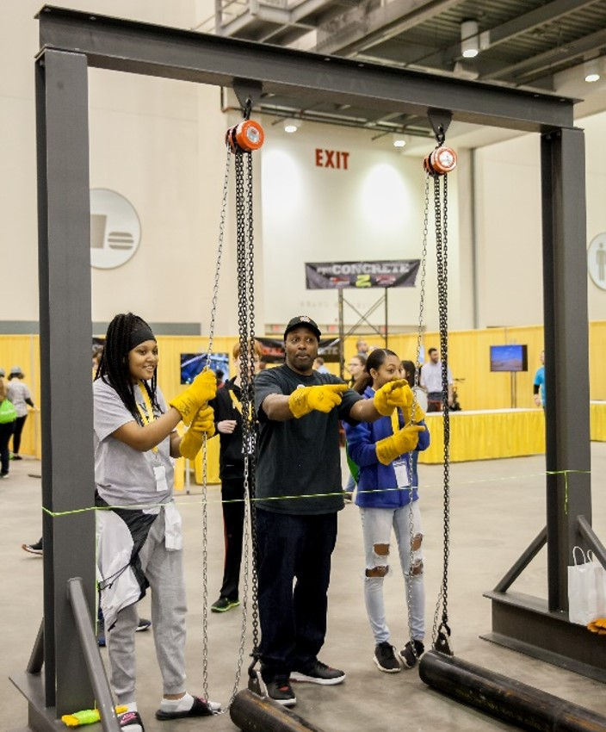
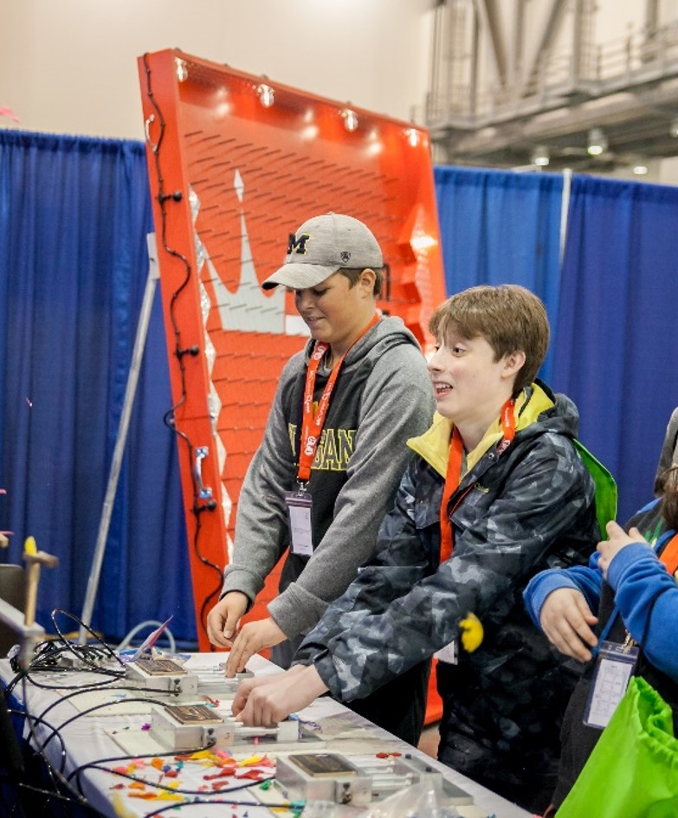
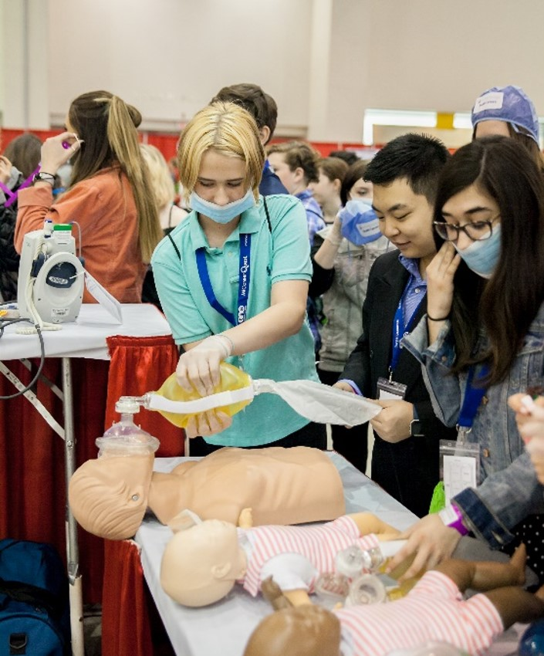
Exhibit Examples
Exhibit Sample
Notes:
Chad – Amy as Back-Up
Slide 29 – Exhibit Examples
Talking Points
Show examples to set expectations for interactive engagement.
Encourage educators to let students explore and ask questions independently.
Ask educators if they had favorite exhibits
Presenters share their favorite exhibits

Slide 30
For those who have attended, what tips do you have?
What is most beneficial to you about MicareerQuest?
What could MicareerQuest do to support you more around career development?
Questions to Attendees
Notes:
Chad – Amy as Back-Up
Presenters ask these questions and take notes

Slide 31
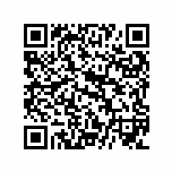
Survey for SCECH credits
Notes:
Chad – Amy as Back-Up
Please fill out the survey. You must fill this out to get SCECH credits

Slide 32
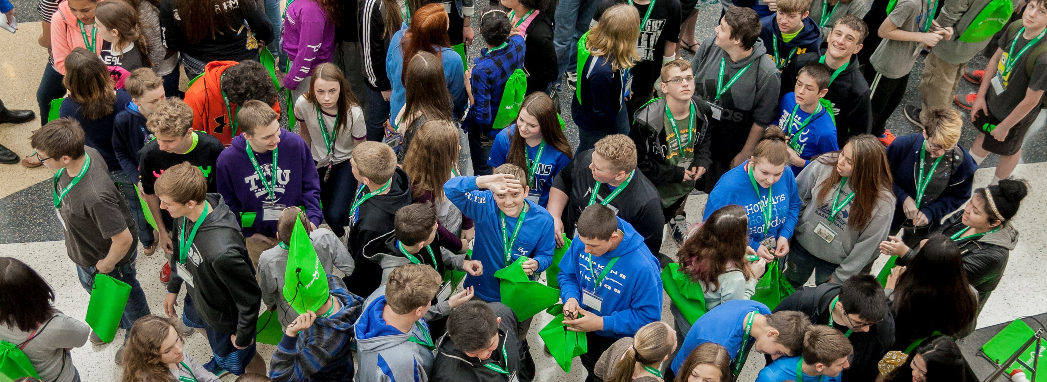
THANK YOU!
THANK YOU!
Notes:
Chad – Amy as Back-Up
We’d like to end our presentation the same way we started: with a big THANK YOU!!

Slide 33
Questions?
Notes:
ALL presenters

