Slide 1
May 20, 2026 | DeVos Place
Notes:
Chad

Slide 2
Introductions
Event Management – West MI Works!
Director of Development and Innovation, Chad Patton
Project Manager, Jennifer Summers
Project Manager, Marlene Brostrom
Industry Council Leads– West MI Works!
Advanced manufacturing lead, Paul Sischo
Agribusiness lead, Carol Distel
Construction lead, Joshua Perkins
Explore hospitality lead, Brittany Gray
Health sciences lead, Brad Sims
Information technology lead, Virginia Berger
Intermediate Schools Districts (ISDs)
Allegan Area Educational Services Agency, Beth Johnston
Barry ISD, Rich Franklin
Ionia ISD, Dane Sanders & Chad Patton
Kent ISD, Krista Harmon and Ryan Graham
Montcalm Area ISD, Penny Dora & Ashley Reisbig
Muskegon Area ISD, Stephen Pettifor
Ottawa Area ISD, David Ladd
Employer Champions
Advanced Manufacturing
  Jake Hall, The Manufacturing Millennial
  Kacey Regan, DeWys Manufacturing
Agribusiness
  Austyn Baldasare, Hearthside Food Solutions
  Aimee Misiewicz, Herbruck’s Poultry Ranch
Construction
  Kevin Lutz, Feyen Zylstra
  John A. Hartwell, Operating Engineers Local 324
Explore Hospitality
  Heather Day, Gerald R. Ford Airport
  Lisa Calhoun, Kent County Hotel Association, Sheraton
  Amy Young, Destination Consultants
Health Sciences
  Steven Smith, University of Michigan Health – West
  Annette McBride, Trinity Health
Information Technology
  Eileen Boekestein, Michigan Department of Environment, Great Lakes, and Energy
  Sharon Vriend-Robinette, Corewell Health Information Technology
Notes:
Chad – thank you to all that participate, this is a community event, shout out to ISDs, WMW staff, employer champions, and ICLs. We are super excited to have agribusiness join the industries for the first in-person event.
Introduce Maggie

Slide 3

In the next five years:
Baby Boomers will be approximately 61-80 years old
The first Gen Xers will become eligible for Social Security and Medicare and begin to retire in 2027
We need to add 4.6 million workers every year to replace them as they retire.
The
Need
What are we doing to ensure they choose a career in:
Agribusiness
Hospitality?
Advanced Manufacturing?
Information Technology?
Health Sciences?
Construction?
Notes:
Chad - We’ve all heard about the “silver tsunami”—the wave of retirements that’s already underway. It’s not just Baby Boomers any more; Generation X will also beginning to retire in significant numbers, and this trend will accelerate over the next decade as more individuals reach age retirement age. This creates a critical challenge: ensuring our region has the skilled workforce needed to sustain and grow our economy.
One powerful solution for our community is MiCareerQuest.
MiCareerQuest is an innovative, hands-on career exploration event designed to connect students with real-world experiences in high-demand industries. It was launched in 2015 through a partnership between Michigan Works! Kent, Allegan & Barry Counties (now West Michigan Works!), Kent ISD, and the Construction Workforce Development Alliance (CWDA). The event was created in direct response to employers’ urgent need for future talent in four key sectors: construction, health care, information technology, and manufacturing.
Since its inception, MiCareerQuest has grown beyond our region. It’s now recognized as a statewide best practice, and similar events—under the CareerQuestUSA banner—are being hosted across the country. These events share the same mission: to expose students to the wealth of career opportunities available in their communities and inspire the next generation of talent.
As we prepare to kick off outreach for this year’s event, remember that MiCareerQuest isn’t just an activity—it’s a strategic investment in our future workforce. Your role in promoting and supporting this initiative helps ensure that students, educators, and employers all see the value and impact of participating.

Slide 4







Industry Talent Councils
The data-based HotJobs! List guides which jobs are featured at the event.
Notes:
Karrie
The event is backed by the 5 employer-led industry talent council, who's logo are displayed on the screen. Each council is committed to solutions to address the skilled workforce needs of West Michigan companies. A few key areas of focus for each industry are: promoting the industry, recruitment, retention, and funding for talent related initiatives.
Who They Are:
Employers, educators, workforce development experts
What They Do:
Create solutions to address the skilled workforce needs of West Michigan companies
One way that they do this:
MiCareerQuest

Slide 5
  What
  Interactive, hands-on, purposeful, inspiring
When
Event Day - Wednesday, May 20, 2026
Arrive by 7:30-7:45 a.m. to park and be on the floor for the industry and volunteer walkthrough at 8 a.m.
Students arrive at 8:30 a.m.
Event ends at 1:45 p.m.
Where
DeVos Place Convention Center
303 Monroe Ave NW, Grand Rapids, MI 49503
Event Overview
Notes:
Karrie
When and where
What:
MiCareerQuest is not your average career fair. In fact, it’s not a career fair at all. It’s a career exploration experience.
During MiCareerQuest, students rotate through sectors highlighting five high-demand industries: agribusiness, advanced manufacturing, construction, health sciences and information technology. Students engage directly with professionals and participate in activities that showcase various high-growth occupations, opening their eyes to opportunities for great careers in West Michigan.
Additionally, representatives from educational institutions help students make the connection between training, education and careers.

Slide 6
DeVos hall will be divided into four industry quadrants.
Industry champions will have interactive, engaging, and motivating exhibits showcasing the career opportunities within their industry.
Higher Education Sponsors will be strategically placed throughout DeVos hall to maximize exposure to students.
Quadrants will be piped and draped in a color matching initial lanyard entrance color, with an entrance and an exit to facilitate student movement.
The Layout
Notes:
Karrie
Session Times Notes:
Student Flow Notes:
Post Event Notes:

Slide 7
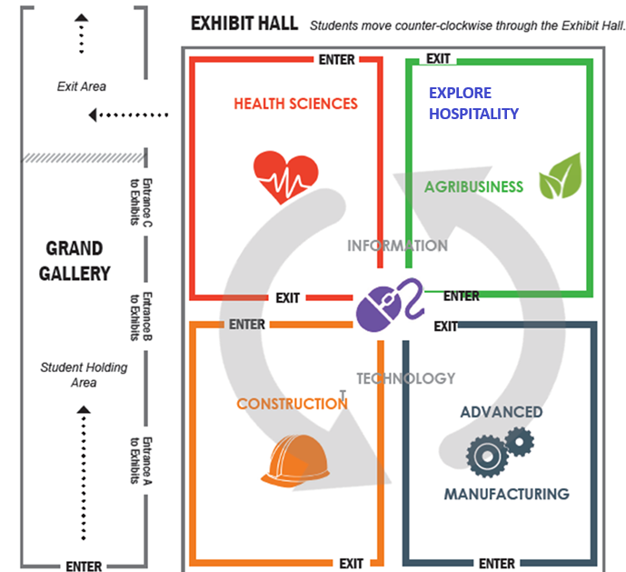
The Layout
Notes:
Karrie
DeVos hall will be divided into four industry quadrants.
Industry champions will have interactive, engaging, and motivating exhibits showcasing the career opportunities within their industry.
Higher Education Sponsors will be strategically placed throughout DeVos hall to maximize exposure to students.
Quadrants will be piped and draped in a color matching initial lanyard entrance color, with an entrance and an exit to facilitate student movement.

Slide 8

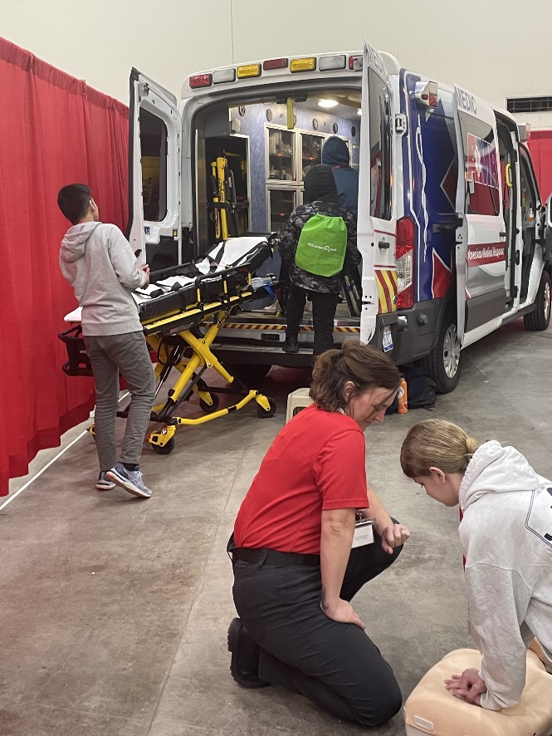
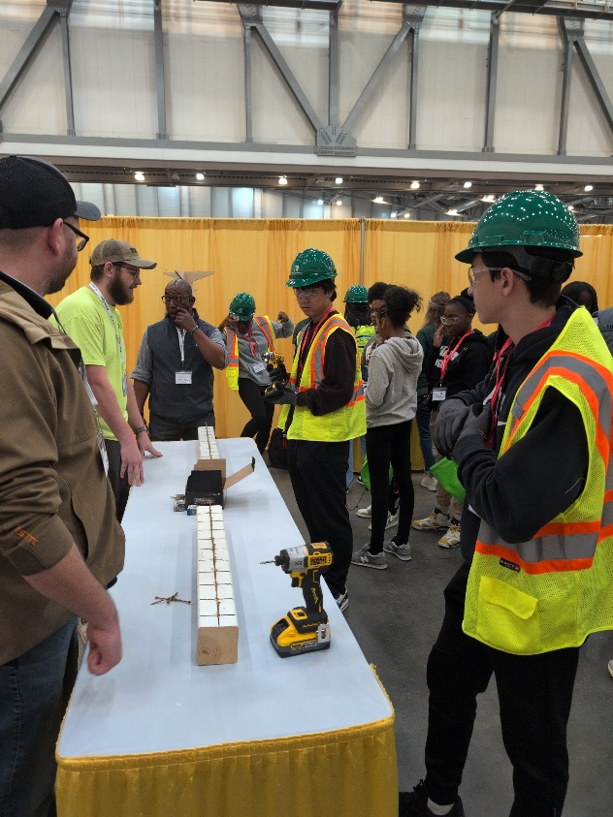
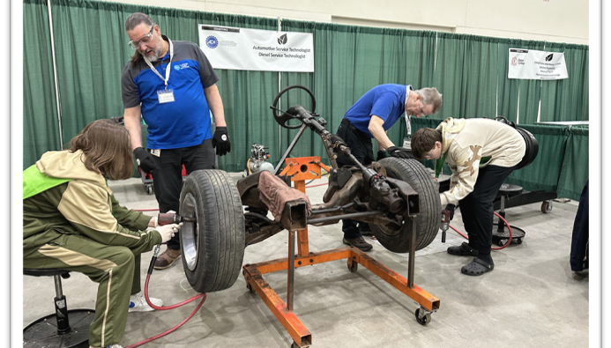
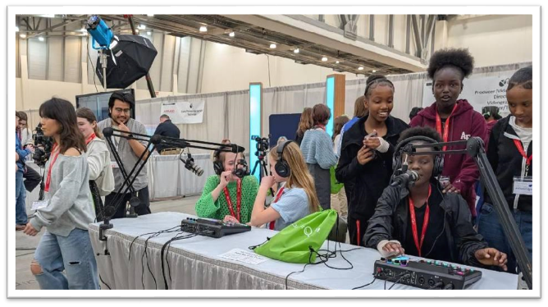
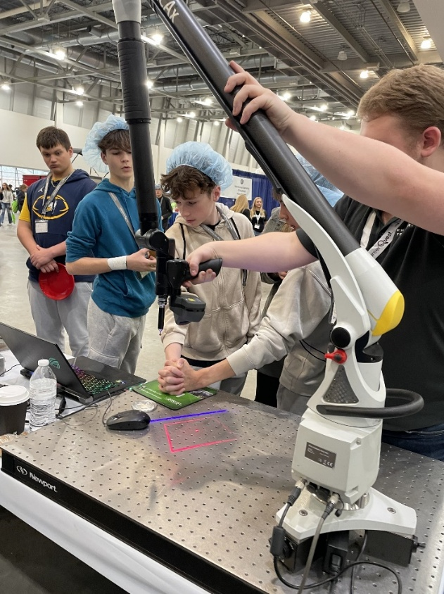
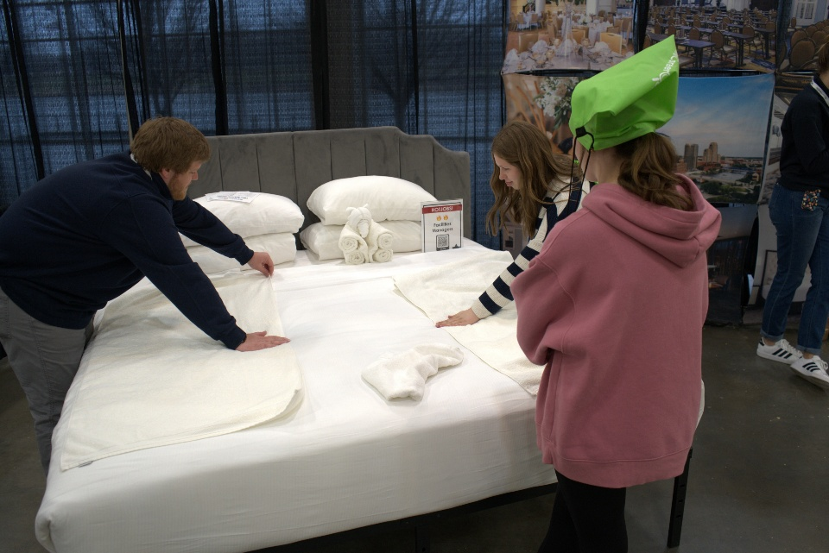
Notes:
Karrie - Students can’t aspire to careers they’ve never seen—and we want to go beyond simply showing them what’s possible. At MiCareerQuest, students don’t just observe; they experience careers through hands-on activities like the ones pictured here. These interactive experiences help students imagine themselves in these roles and spark curiosity about their future.
During the event, students rotate through sectors that highlight our six high-demand industries. They meet industry professionals, ask questions, and participate in activities that demonstrate what these careers look like day-to-day. This approach opens their eyes to opportunities for rewarding careers right here in West Michigan.
In addition, representatives from educational institutions are on hand to help students connect the dots between training, education, and career pathways. This ensures they leave with a clearer understanding of what it takes to pursue these opportunities.
To give you a sense of scale, this past spring nearly 8,500 students attended MiCareerQuest. They engaged with more than 110 companies and explored over 290 different jobs. That’s a powerful impact—and it’s why your role in promoting this event is so important.

Slide 9
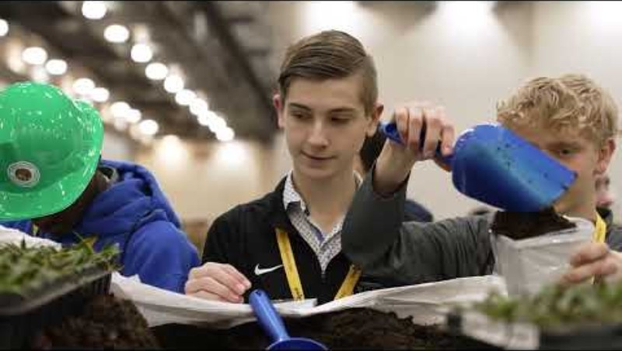
What is MiCareerQuest?
Notes:
Karrie
Employers participating in their first MiCQ event, often stat they wish they was a better way to prepare employers for what they would experience. This video showcases activities from a previous event
We would like play that for you now.

Slide 10
    8,128 students registered.
    99 participating employers
    309 careers featured
2026 Highlights
“What I liked best was that it showed how many different options there were for things I could do after high school, it was nice to see things that i wasn't interested in before :)” – 2025 Student Participant
Notes:
Chad

Slide 11
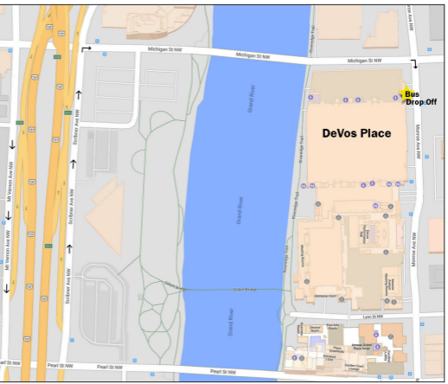
Buses will line up on SCRIBNER AVENUE and wait to be directed by event staff to proceed to drop off.
Buses will turn right onto MICHIGAN then turn right onto MONROE AVE.
Buses will drop off at the designated area on MONROE AVE (volunteers will be present to assist).
For the safety of students there will be NO DOUBLE PARKING TO UNLOAD.
Please unload as quickly as possible
Volunteers will be present to enforce the drop off process
Pick up will be on SCRIBNER AVE
Arrival
Notes:
Chad

Slide 12
Every student and chaperone should have lanyard and every student should have a backpack. No outside student backpacks allowed except medical devices.
Every exhibitor should have a lanyard
Every tour guest and media contact should have a lanyard
Every volunteer should have a bright orange shirt
If someone doesn’t have one of these, point to info desk
No storage for personal items
Wear comfortable shoes! No high heels, no new shoes
DRESS FOR YOUR ROLE! Are you outside? Do you need sunblock? Gloves?
Arrival: outfits and suggestions
Notes:
Chad

Slide 13
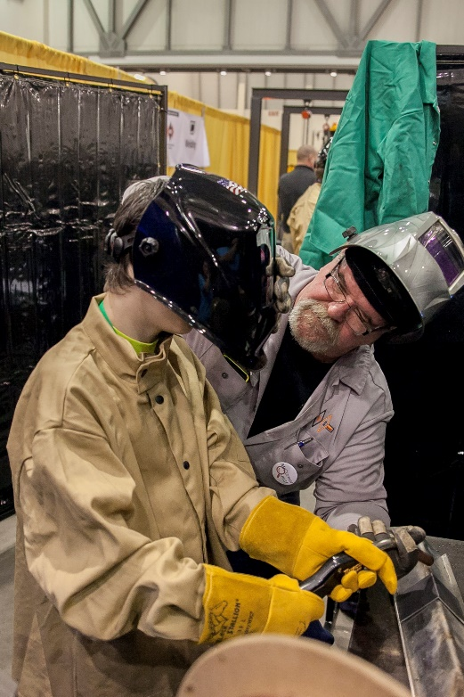
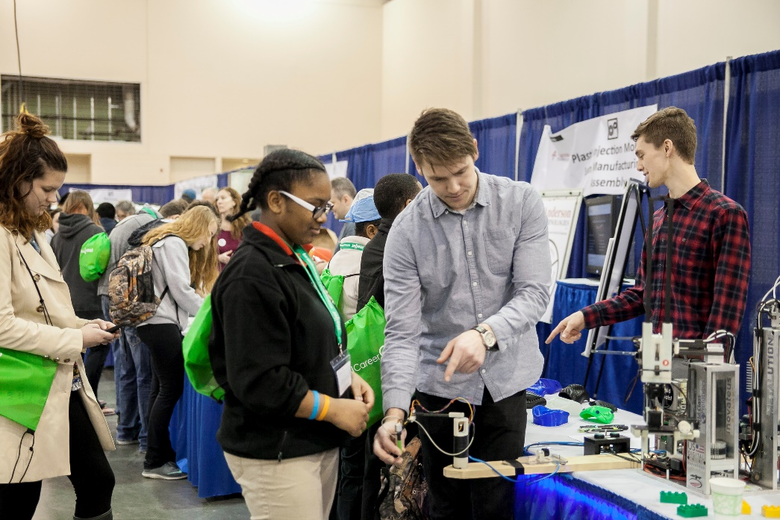
Students come in from one of three sessions:
    8:30 am – 10:15 am
    10:15 am – noon
  noon – 1:45 pm
  Students start in one of the exhibit spaces and move throughout the hall to experience all six industries. Music plays when it is time to switch areas.gns with their arrival time (see event schedule document)
Student Experience
Notes:
Chad

Slide 14
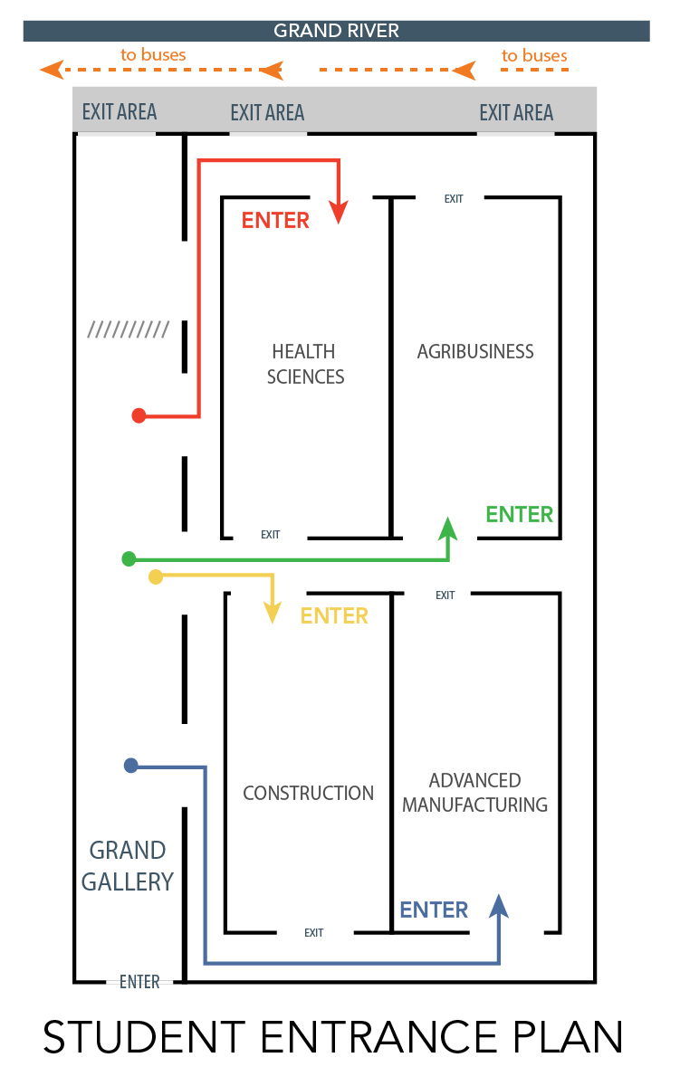
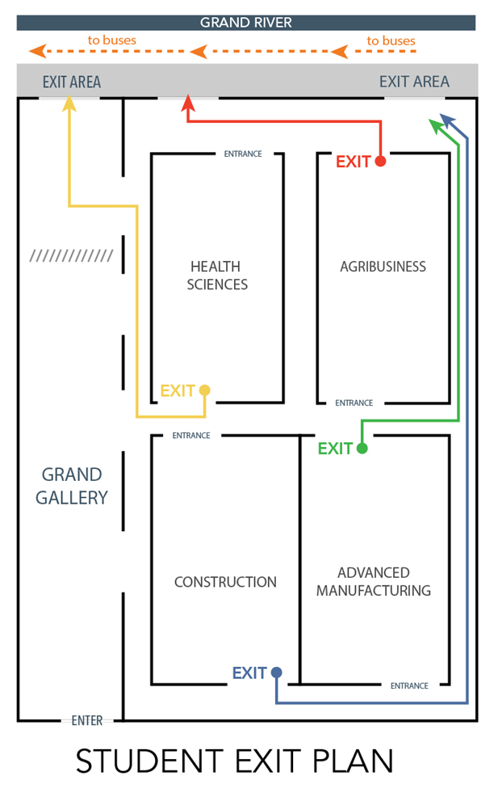



Student Flow
Notes:
Chad

Slide 15
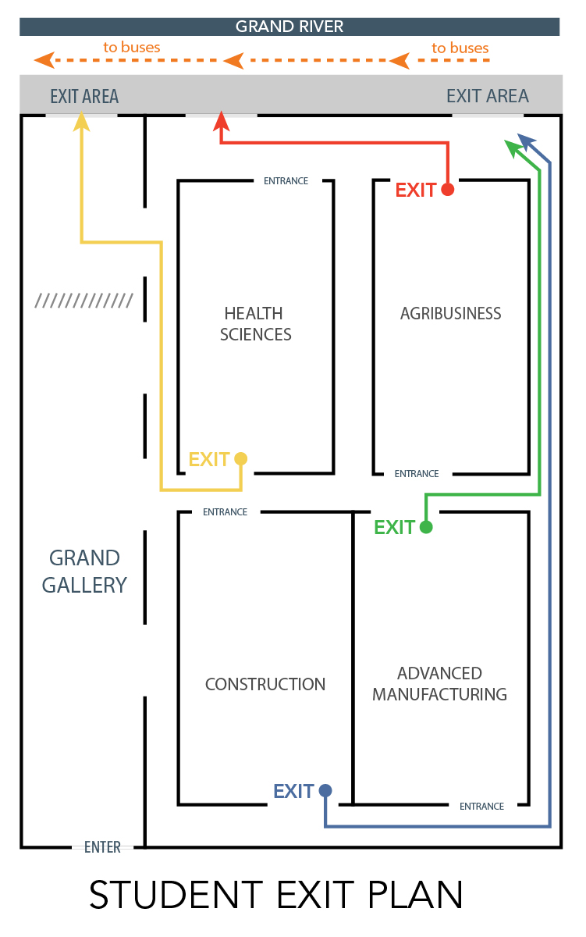
EXIT PLANS
Color papers will show doors to exit from
Carpool/chaperone-driven students: Exit same way. After DeVos Place building, break left to go to parking lot (bus driven students will go right to go over Grand River)
Exit Plan on
every student lanyard
Notes:
Chad

Slide 16
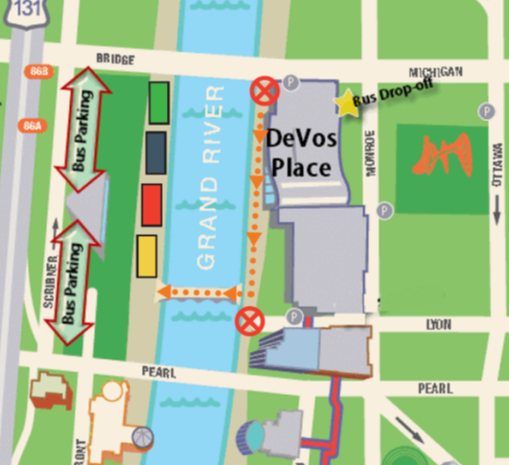
Exterior Exit Plan
Breakaway for chaperone-driven students
School signs used to meet students here
Notes:
Chad

Slide 17
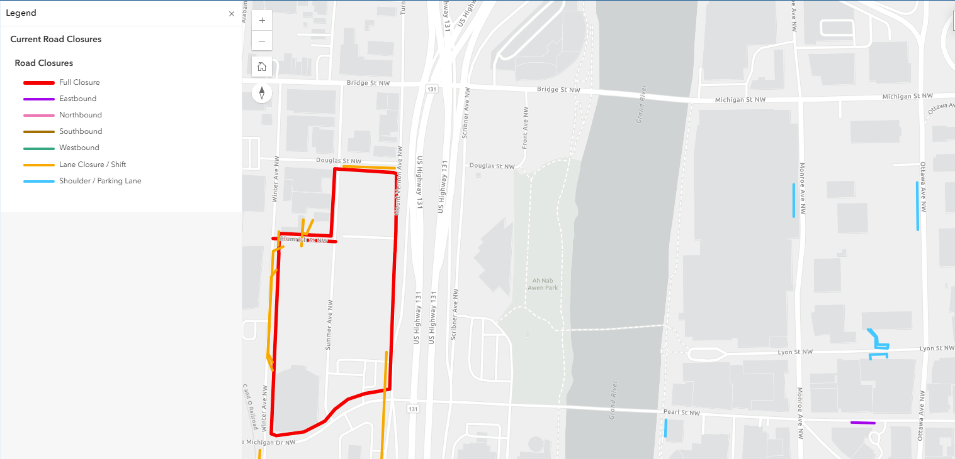
Mt. Vernon is down to a single lane due to soccer stadium contruction
No other major road closures to note this year
Road Closures
Notes:
Chad

Slide 18
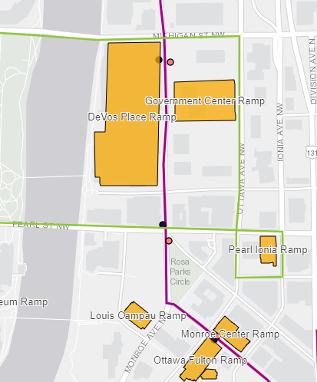
        Underneath DeVos Place (entrance off Michigan Street or Lyon St)
        Overflow in the Government Parking Ramp across Monroe.
            Parking vouchers will be provided (one/person/day). SAY NO TO EVENT PARKING
Parking
        DO NOT PARK IN OTHER LOTS!!!
Notes:
Chad

Slide 19
Volunteers
Notes:
Chad

Slide 20
Runners: Dispatch Office, Grand Gallery
Industry Guides: WMW Sector Tables, Exhibit Hall
Grand Gallery Flow: Box Office, Grand Gallery
Exit Flow: Box Office, Grand Gallery
Exhibit Hall Flow: Box Office, Grand Gallery
Transportation: Main Entrance, Grand Gallery
Please note: Transportation volunteers are to meet at 7:45AM at the Monroe entrance
Volunteer Meeting Points
Notes:
Chad

Slide 21
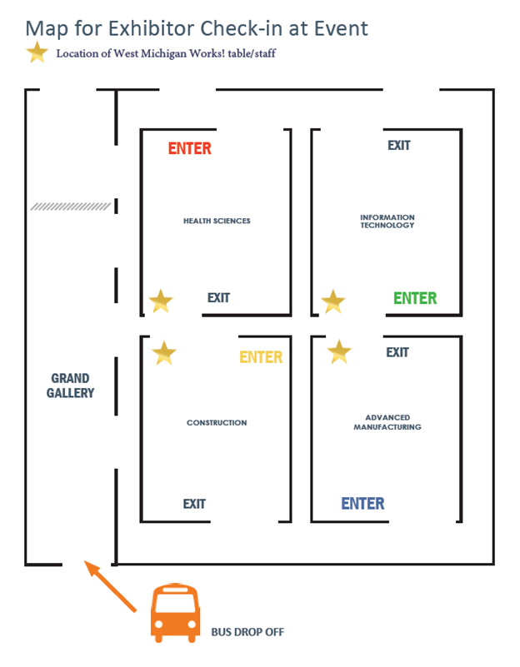
Industry Area Check In
Notes:
Chad

Slide 22
Bus Arrival, Bus Greeters A, Bus Greeters B
Grand Gallery Floor, Grand Gallery Exhibit Hall Door Guards
Student Guides, Exhibit Hall
Industry Guides
Student Safety
WMW Quadrant Information
Floating Runners
VIP Tour Check In
Info Desk
Exit - Flag Holders
Volunteer Positions
Notes:
Chad

Slide 23
    ALL DAY VOLUNTEER SCHEDULE:
      Arrival/Park 7:30 am
      Check-in: 7:45 am
      Volunteer Tours: 8:00 am
      Lunch (by rotation): 11:00 am – 1:00 pm
      Clean Up: 1:45 pm
      Depart When clean up is complete.
    LUNCH – BY LAST NAME
      A-D 11:00 - 11:30
      E-H 11:30 – Noon
      I-N Noon – 12:30
      O-Z 12:30 – 1:00
Volunteer Schedule
OTHER BREAKS – Take as needed, just please ensure you are covered.
Notes:
Chad

Slide 24
Exhibitors
Notes:
Amy

Slide 25
COMPANY PROMOTION & SIGNAGE
Non-career related company banners or table clothes are not allowed. Each exhibit will receive a standard identification sign with the occupation(s) and logo(s) of the participating exhibitors. These banners will be hung by volunteers on set-up day.
Distribution of papers such as brochures, promotional items, pamphlets, and flyers, are not permitted within the exhibit hall quadrants.
    However, distribution of papers such as brochures, pamphlets, and flyers, are permitted at the following tables:
      Sponsoring Educator tables located on the east side of the exhibit hall, just outside of the industry quadrants
      Sponsoring Educators may advertise their training programs within the exhibit hall quadrant(s).
Swag items are permitted if they are produced, generated, or earned by an attendee as part of the interactive portion of an exhibit. Swag must be related to the occupation.
Please note that balloons and latex gloves are not allowed at the event venue. Try to avoid giving out peanuts!
Exhibitor Guidelines
Notes:
Amy

Slide 26
DRESS CODE
Exhibitors representing their trade should come dressed as they would on the job.
Comfortable Shoes: Don’t forget that you’ll be working long hours on your feet and to dress accordingly. You can dress professionally and still be comfortable if you keep a few things in mind:
    Your shoes will make or break your comfort when you’re on your feet for hours. Avoid high heels and sandals; toe and foot injuries are common in areas where there is a lot of wiring for dozens of exhibits.
    Avoid wearing new shoes or you may wind up having aching, blistered feet by the end of the day.
    The Exhibit Hall is concrete. The harder the floor, the more comfortable your shoes will need to be.
Exhibitor Guidelines
Notes:
Amy

Slide 27
Project Leads – Raise your hand if you are in the room
Exhibit Supplies: Please contact your Industry Council Lead if you would like a copy of your supply order
Designated Industry set-up times: Reference “Move In/Move Out” hand out
  Agribusiness, Hospitality, and Health Sciences can load in between 1pm – 3pm
Set-up Process
      Check in at WMW! Tables (center of exhibit hall)
      No supply check out from 12p-1p
      Supply Order Form Provided upon arrival (WiFi Password provided at check-in)
      Parking Validation Provided just for set-up day
Set-Up:
May 19
Notes:
Amy

Slide 28
Emergency Procedure
If there is an emergency that comes up, help can be requested by
contacting any one of the following individuals:
Call the DeVos security office directly at 616-742-6640
Make contact with one of the DK security guards roaming the Grand Gallery/ Exhibit Hall (they can be identified by their unioform, which is a yellow DK polo and black pants), who will then contact DeVos security
Make contact with anyone in an orange MiCareerQuest T-shirt, who will then contact DeVos security
This information will be placed in the key contact list for reference for the day of event and provided to Employer Champions, West Michigan Works! Sector Leads and quadrant table staff, and the Grand Gallery Information Desk staff.
Notes:
Amy

Slide 29
ALL ATTENDEES WILL HAVE AN IDENTIFIER
Anyone without an identifier should be asked to go to the Info Desk.
Students and school personnel: MICQ lanyards in primary colors with name badges attached.
Volunteers: MICQ t-shirts in orange.
Exhibitors: MICQ lanyards in white with name badges attached.
Tour participants and guests: MICQ lanyards in white with name badges attached.
Safety Continued
Notes:
Amy

Slide 30

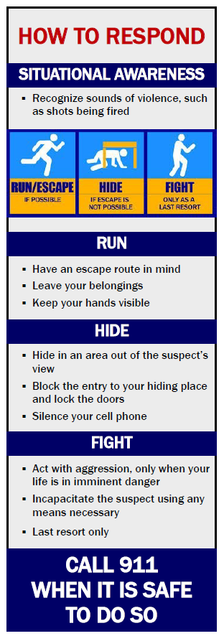
Safety Continued
BE SITUATIONALLY AWARE
Note your surroundings
Locate the closest exits
Look around and listen for anything that seems out of place
Use common sense
If you see something, say something!
Notes:
Amy

Slide 31
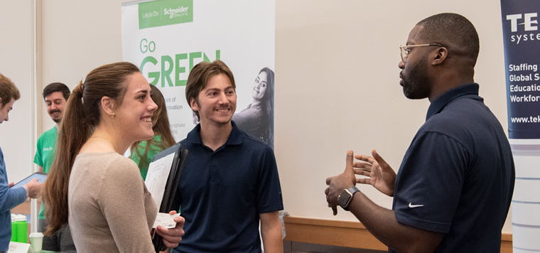
Be likeable
Show some enthusiasm
Keep it simple and jargon-free
Explain the why, not just the what
Make it a conversation, not a speech
Give them something worth remembering
Engagement Tips
Notes:
Chad

Slide 32


Practice in a mirror first
Practice with a colleague
Practice scenarios
Engagement Tips
Notes:
Chad

Slide 33
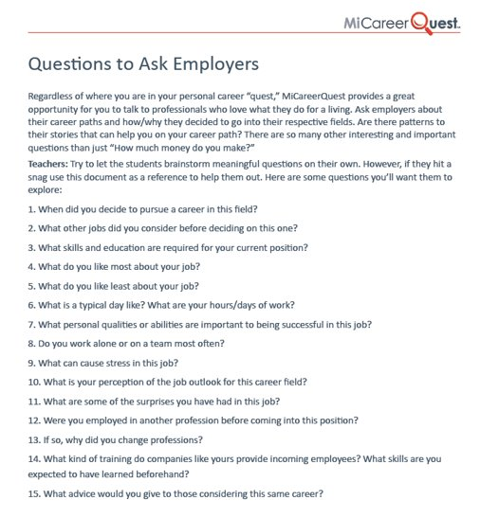
Engagement Tips
Notes:
Chad – Remember these are questions employers may get asked

Slide 34
  Concession stand at the DeVos Place will be open to purchase concessions from:​
  6:30am - 8:30am on May 20
  Vehicle Display – Fire Marshal Inspection​
    Fire Marshal will inspect at 3pm
    Power should be fully hooked up to each exhibit
    Exhibitors should have someone at their exhibit
  Volunteer Survey​: Tell us what you think! In order to enhance the next MiCareerQuest experience, we depend on feedback from you. ​An electronic survey will be emailed to you immediately following the event. Your input is critically important. ​
  NOTE: Due to budget constraints, we are unable to provide a post-event happy hour
More information

Slide 35
Questions?

Slide 36
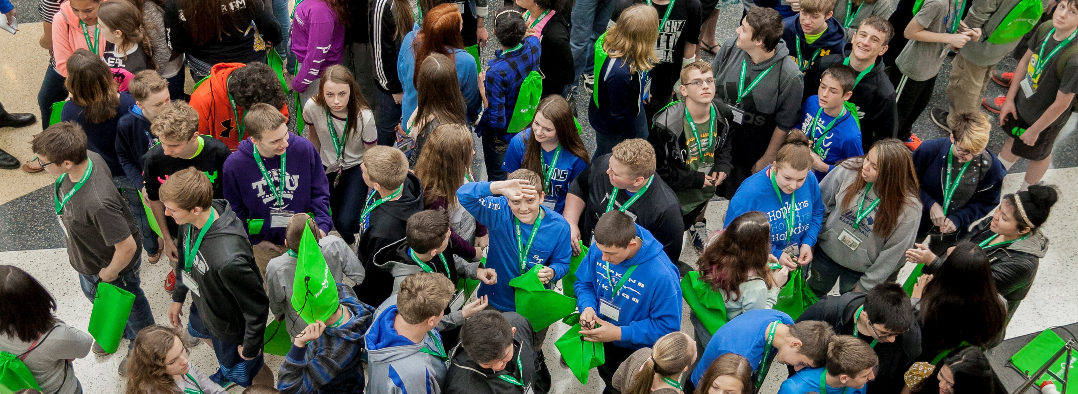
THANK YOU!
THANK YOU!
Volunteers – Pick up T-Shirts
Notes:
We’d like to end our presentation the same way we started: with a big THANK YOU!!

